Slide 1
Introduction to NVivo For Qualitative Researchers
Alex Shermon | Research Computing Services | The University of Melbourne

Slide 2
Today’s Agenda
Introduction
What is NVivo?
Challenges with NVivo
Next Steps

Slide 3
Introduction

Slide 4
Who am I?
Student in Masters of Global Media Communications
Research Assistant
Project Officer at the Digital Studio
Omeka and NVivo Research Community Coordinator
You can follow me on twitter @alexshermon and can get in touch via email at alex.shermon@unimelb.edu.au

Slide 5
Icebreaker
Who are you?
What are you researching?
Favourite pet?

Slide 6
Today’s Learning Objectives
By the end of today’s workshop you will (hopefully) understand:
What NVivo is and how it works
How to:
Import files into NVivo
Code files in NVivo
Code cases and create case classifications in NVivo
Create a Word Cloud in NVivo

Slide 7
What Do I Do with NVivo?
I Use NVivo to help me conduct thematic analysis on news opinion editorials to explore changes in conservative media discourse in Australia.
NVivo helps me to:
Organise and store my files
Categorise and analyse my data
Visualise my data and discover new insights

Slide 8

Qualitative Research Methods (Briefly)
Broadly concerned with:
Gathering non-numerical data:
Interviews
Texts
Images
Analysing this data in reference to:
Meanings
Concepts
Symbols

Slide 9
DISCLAIMERS

Slide 10
NVivo does not do your research for you!

Slide 11
2. There is a difference between NVivo on Mac and NVivo on Windows

Slide 12
2. What is NVivo?

Slide 13

What is NVivo?
A Qualitative Analysis tool developed by QSR International
3 Key Functionalities:
Store and Organise
Categorise and Analyse
Visualise and Discover

Slide 14
Key Terms
Files: The materials (or data) that you want to analyse
Code: The process of gathering information from your files about topics relevant to your research interests (very similar to a ‘tag’)
Nodes: A container for your coded information
Cases: Nodes that represent ‘units of observation’ such as people, places, organisations, or events.

Slide 15
3. Cool Stuff in NVivo!

Slide 16
Today’s Challenges
Store and Organise: Import Files
Categorise and Analyse: Code themes and cases
Visualise and Discover: Create a Word Cloud

Slide 17









Store and Organise

Slide 18
Challenge 1: Importing Files into NVivo
Open NVivo
Open either a blank project or the sample project
Create a folder for “workshop interviews”
Upload any, or as many, files as you want!
Sample Files (Dropbox):http://go.unimelb.edu.au/o3vr

Slide 19
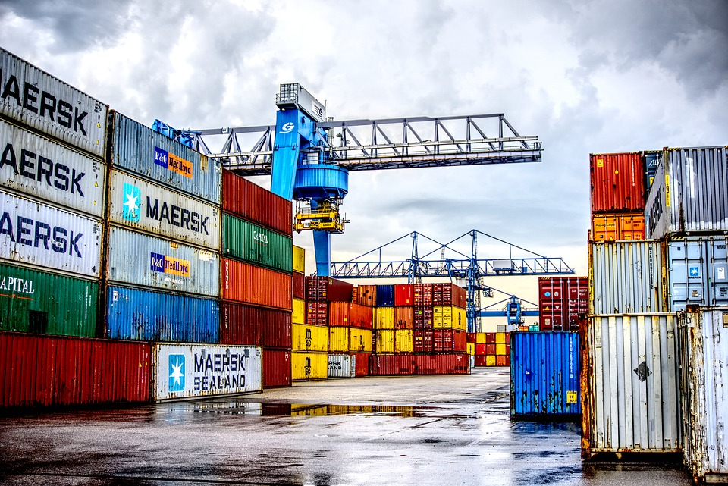


2. Categorise and Analyse
Themes, Sentiment, Relationships, Cases
Analyse your research findings, organise your nodes, iterate!

Slide 20
Challenge 2: Coding Files in NVivo
Create a node for “economy”, “community”, and “memorable quotes”
Drag relevant text from the data into these nodes
Rinse and repeat!

Slide 21
10 Minute Break

Slide 22
Cases and Case Classifications
Case Classification Example: Person
Contains attributes that you assign to individual units of observation
Case example: Barbara
Has specific information assigned to the attributes you created in the classification

Slide 23
Challenge 3: Coding Cases in NVivo
Create a Case Classification for people with attributes
Create a case for your interviewee
Drag the relevant information into this case
Assign values to the attributes for your individual cases

Slide 24
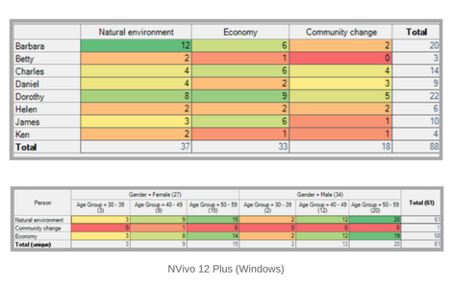
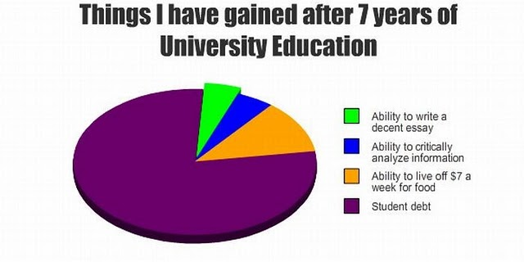
3. Visualise and Discover

Slide 25
Challenge 4: Creating a Word Cloud
Using the “explore” tab (queries on Mac), try and figure out how to create a word cloud with NVivo!
Hint: Work Together
Bonus task: Customise and refine the words that appear in the Cloud

Slide 26
Want to know more?
Attend my Intermediate Workshops!

Slide 27
4. Conclusion and Your Future

Slide 28
What Have We Learnt Today?
I know what NVivo is
I understand how to:
Import files into NVivo
Code those files
Code cases and create case classifications
Create a word cloud

Slide 29
Next Steps
NVivo Intermediate Workshop
Revisiting Cases
Sentiment Coding
Memos and Annotations
More Visualisations
Community Meetups
Specialised Topics (e.g. How to do a Literature Review)

Slide 30
Interested in Helping Out? Become a ResLead!
Get involved in the researcher community:
Help out at future workshops (improve your own knowledege)
Run drop-in sessions in your own faculty
Contribute to meetups
Find me on twitter @alexshermon or via email at alex.shermon@unimelb.edu.au

Slide 31
Upcoming Events - Research Computing Services
Introduction to NVivo
13th March 2-4pm
http://go.unimelb.edu.au/6j9r
Intermediate Workshop
19th March 11-1pm
http://go.unimelb.edu.au/xj9r

Slide 32
Upcoming Events - The Digital Studio
Does the Future Have a Past? New-Old and Old-New Virtual Realities
11th March 1-2pm
http://go.unimelb.edu.au/rj9r
Introduction to R For Social Scientists and Humanists
19th March 10-12pm
http://go.unimelb.edu.au/jj9r

Slide 33
Thank You!
To make these workshops as good as they can be, I need YOUR feedback!
Please fill in the feedback form here: http://go.unimelb.edu.au/o8gr
Sign up to my newsletter: eepurl.com/gExj6f
Any Questions?
alex.shermon@unimelb.edu.au

